Slide 1
Decision Tree
By,
Shree Manju H (17TUIT134)
Vignesh G (17TUIT151)
Vignesh S (17TUIT152)
Vijayvarman R (17TUIT153)
Yuva Ajay A (17TUIT157)

Slide 2
Introduction
A decision tree is a decision support tool that uses a tree-like model of decisions and their possible consequences, including chance event outcomes, resource costs, and utility. It is one way to display an algorithm that only contains conditional control statements.
It is a flowchart-like structure in which each internal node represents a "test" on an attribute (e.g. whether a coin flip comes up heads or tails), each branch represents the outcome of the test, and each leaf node represents a class label (decision taken after computing all attributes). The paths from root to leaf represent classification rules.

Slide 3
Types of Decision trees
A decision tree consists of three types of nodes
Decision nodes – typically represented by squares
Chance nodes – typically represented by circles
End nodes – typically represented by triangles

Slide 4
Advantages
Are simple to understand and interpret. People are able to understand decision tree models after a brief explanation.
Have value even with little hard data. Important insights can be generated based on experts describing a situation (its alternatives, probabilities, and costs) and their preferences for outcomes.
Help determine worst, best and expected values for different scenarios.
Use a white box model. If a given result is provided by a model.
Can be combined with other decision techniques.

Slide 5
Disadvantages
They are unstable, meaning that a small change in the data can lead to a large change in the structure of the optimal decision tree.
They are often relatively inaccurate. Many other predictors perform better with similar data. This can be remedied by replacing a single decision tree with a random forest of decision trees, but a random forest is not as easy to interpret as a single decision tree.
For data including categorical variables with different number of levels, information gain in decision trees is biased in favor of those attributes with more levels.
Calculations can get very complex, particularly if many values are uncertain and/or if many outcomes are linked.

Slide 6
Applications
Business Management
Customer Relationship Management
Fraudulent Statement Detection
Fault Diagnosis
Health Care Management
Agriculture
Engineering, Energy Consumption

Slide 7
Implementation of Decision Tree in R
Problem Statement: To study a Mushroom data set in order to predict whether a given mushroom is edible or poisonous to human beings.
Data Set Description: The given data set contains a total of 8124 observations of different kind of mushrooms and their properties such as odor, habitat, population, etc. A more in-depth structure of the data set is shown in the demo below.
Logic: To build a Decision Tree model in order to classify mushroom samples as either poisonous or edible by studying their properties such as odor, root, habitat, etc.

Slide 8
Step 1: Install and load libraries
#Installing libraries
install.packages('rpart')
install.packages('caret')
install.packages('rpart.plot')
install.packages('rattle')
#Loading libraries
library(rpart,quietly = TRUE)
library(caret,quietly = TRUE)
library(rpart.plot,quietly = TRUE)
library(rattle)

Slide 9
Step 2: Import the data set
#Reading the data set as a dataframe
mushrooms <- read.csv ("/Users/zulaikha/Desktop/decision_tree/mushrooms.csv")
Now, to display the structure of the data set, you can make use of the R function called str():
# structure of the data
> str(mushrooms)

Slide 10
'data.frame': 8124 obs. of 22 variables:
$ class : Factor w/ 2 levels "e","p": 2 1 1 2 1 1 1 1 2 1 ...
$ cap.shape : Factor w/ 6 levels "b","c","f","k",..: 6 6 1 6 6 6 1 1 6 1 ...
$ cap.surface : Factor w/ 4 levels "f","g","s","y": 3 3 3 4 3 4 3 4 4 3 ...
$ cap.color : Factor w/ 10 levels "b","c","e","g",..: 5 10 9 9 4 10 9 9 9 10 ...
$ bruises : Factor w/ 2 levels "f","t": 2 2 2 2 1 2 2 2 2 2 ...
$ odor : Factor w/ 9 levels "a","c","f","l",..: 7 1 4 7 6 1 1 4 7 1 ...
$ gill.attachment : Factor w/ 2 levels "a","f": 2 2 2 2 2 2 2 2 2 2 ...
$ gill.spacing : Factor w/ 2 levels "c","w": 1 1 1 1 2 1 1 1 1 1 ...
$ gill.size : Factor w/ 2 levels "b","n": 2 1 1 2 1 1 1 1 2 1 ...
$ gill.color : Factor w/ 12 levels "b","e","g","h",..: 5 5 6 6 5 6 3 6 8 3 ...
$ stalk.shape : Factor w/ 2 levels "e","t": 1 1 1 1 2 1 1 1 1 1 ...
$ stalk.root : Factor w/ 5 levels "?","b","c","e",..: 4 3 3 4 4 3 3 3 4 3 ...
$ stalk.surface.above.ring: Factor w/ 4 levels "f","k","s","y": 3 3 3 3 3 3 3 3 3 3 ...
$ stalk.surface.below.ring: Factor w/ 4 levels "f","k","s","y": 3 3 3 3 3 3 3 3 3 3 ...
$ stalk.color.above.ring : Factor w/ 9 levels "b","c","e","g",..: 8 8 8 8 8 8 8 8 8 8 ...
$ stalk.color.below.ring : Factor w/ 9 levels "b","c","e","g",..: 8 8 8 8 8 8 8 8 8 8 ...
$ veil.color : Factor w/ 4 levels "n","o","w","y": 3 3 3 3 3 3 3 3 3 3 ...
$ ring.numbera : Factor w/ 3 levels "n","o","t": 2 2 2 2 2 2 2 2 2 2 ...
$ ring.type : Factor w/ 5 levels "e","f","l","n",..: 5 5 5 5 1 5 5 5 5 5 ...
$ spore.print.color : Factor w/ 9 levels "b","h","k","n",..: 3 4 4 3 4 3 3 4 3 3 ...
$ population : Factor w/ 6 levels "a","c","n","s",..: 4 3 3 4 1 3 3 4 5 4 ...
$ habitat : Factor w/ 7 levels "d","g","l","m",..: 6 2 4 6 2 2 4 4 2 4 ...

Slide 11
Step 3: Data Cleaning
At this stage, we must look for any null or missing values and unnecessary variables so that our prediction is as accurate as possible. In the below code snippet I have deleted the ‘veil.type’ variable since it has no effect on the outcome. Such inconsistencies and redundant data must be fixed in this step.
# number of rows with missing values
nrow(mushrooms) - sum(complete.cases(mushrooms))
# deleting redundant variable `veil.type`
mushrooms$veil.type <- NULL

Slide 12
Step 4: Data Splicing
Data Splicing is the process of splitting the data into a training set and a testing set. The training set is used to build the Decision Tree model and the testing set is used to validate the efficiency of the model. The splitting is performed in the below code snippet:
#data splicing
set.seed(12345)
train <- sample(1:nrow(mushrooms),size = ceiling(0.80*nrow(mushrooms)),replace = FALSE)
# training set
mushrooms_train <- mushrooms[train,]
# test set
mushrooms_test <- mushrooms[-train,]

Slide 13
Step 5: Building a model
In this stage, we’re going to build a Decision Tree by using the rpart (Recursive Partitioning And Regression Trees) algorithm:
# building the classification tree with rpart
tree <- rpart(class~.,
data=mushrooms_train,
parms = list(loss = penalty.matrix),
method = "class")
Step 6: Visualising the tree
In this step, we’ll be using the rpart.plot library to plot our final Decision Tree:
# Visualize the decision tree with rpart.plot
rpart.plot(tree, nn=TRUE)

Slide 14
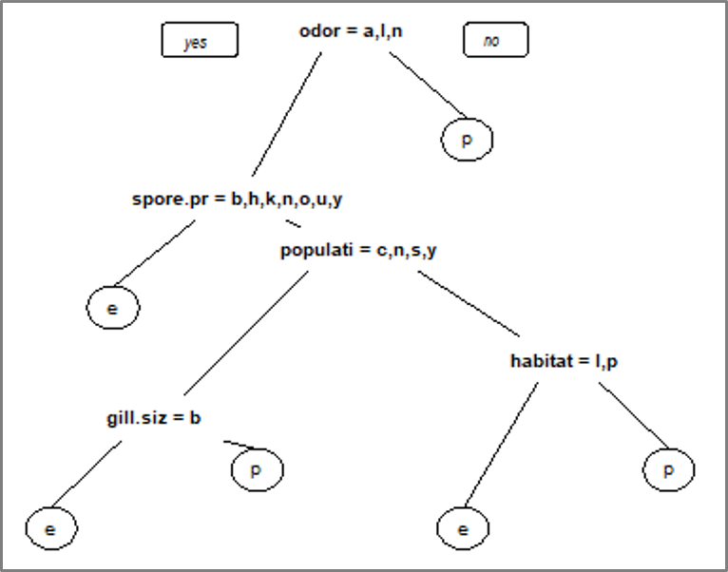

Slide 15
Step 7: Testing the model
#Testing the model
pred <- predict(object=tree,mushrooms_test[-1],type="class")
Step 8: Calculating accuracy
#Calculating accuracy
t <- table(mushrooms_test$class,pred) > confusionMatrix(t)
Confusion Matrix and Statistics

Slide 16
pred
e p
e 839 0
p 0 785
Accuracy : 1
95% CI : (0.9977, 1)
No Information Rate : 0.5166
P-Value [Acc > NIR] : < 2.2e-16
Kappa : 1
Mcnemar's Test P-Value : NA
Sensitivity : 1.0000
Specificity : 1.0000
Pos Pred Value : 1.0000
Neg Pred Value : 1.0000
Prevalence : 0.5166
Detection Rate : 0.5166
Detection Prevalence : 0.5166
Balanced Accuracy : 1.0000
'Positive' Class : e

Slide 17
Conclusion
The output shows that all the samples in the test dataset have been correctly classified and we’ve attained an accuracy of 100% on the test data set with a 95% confidence interval (0.9977, 1). Thus we can correctly classify a mushroom as either poisonous or edible using this Decision Tree model.

